Slide 1

Home security and door control using rapid face detection method
Aditya Srinivas B - 122003016
Heshwa B - 122003091
Kkrish N A - 122003120
Guide
Dr. A. Suganya
Asst. Professor – II, CSE / SoC

Slide 2

Base Paper
Title: A fast face detection method via convolutional neural network
Year: 2019
Journal - Neurocomputing
Indexing - SCI
Publisher - Elsevier
Base paper URL: https://www.sciencedirect.com/science/article/abs/pii/S0925231219309075

Slide 3
Status of Guide Approval
Yes, we got approved sir!

Slide 4
Abstract
The detection speed is still the biggest bottleneck, which hinders the practical deployment of these face detectors on resource-limited platforms and can’t be used effectively in real-time applications.
Products nowadays require a faster response from the sensors to prevent something worse to happen. To address this issue, a face detection method based on discriminative complete features (DCFs) is to be used and the efficiency of the face detector is significantly improved.
Since many thefts have been happening, the security of homes is becoming vulnerable every day. To secure us from this, a camera can be fitted in the door’s peephole to detect and monitor according to users need.
If any movements of a person are detected in front of the door, it alerts the user and streams the live video, if the user requests.
Simultaneously this face detection model detects the face, captures a snap of their face and sends it to the user’s application. Then the user can take action from remote, whether to allow the person or not.

Slide 5
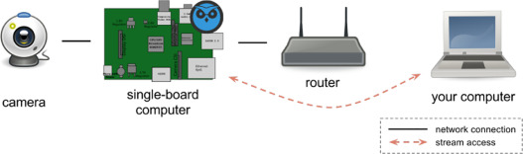
Proposed System
Implement this Face detection model into our home security system.
Whenever a person shows up, this model detects the person’s face sooner.
The detected face is then captured.
The image is then transferred to the user through Raspberry Pi computer via Internet.
The user receives a notification in mobile app.
He/she can control the door’s function to whether allow the person or not.

Slide 6

Methodology

Slide 7
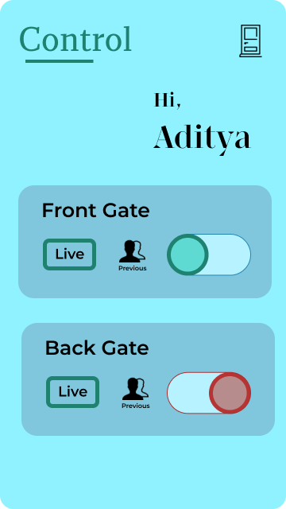
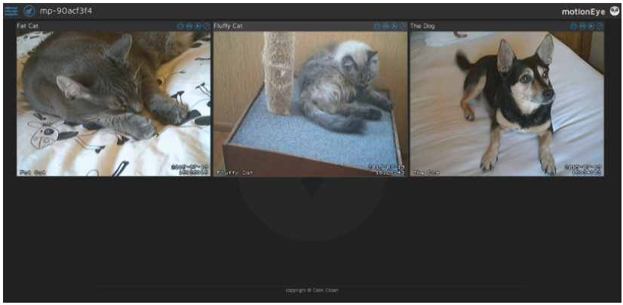

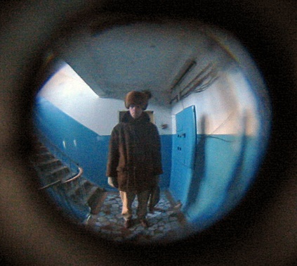

App
Control the door
Live stream / see past detections.
SOS feature
Analyze who are all coming in a timeframe
Face recognition for detected faces (If time permits)
Door 1
Door 2
Door 3

Slide 8
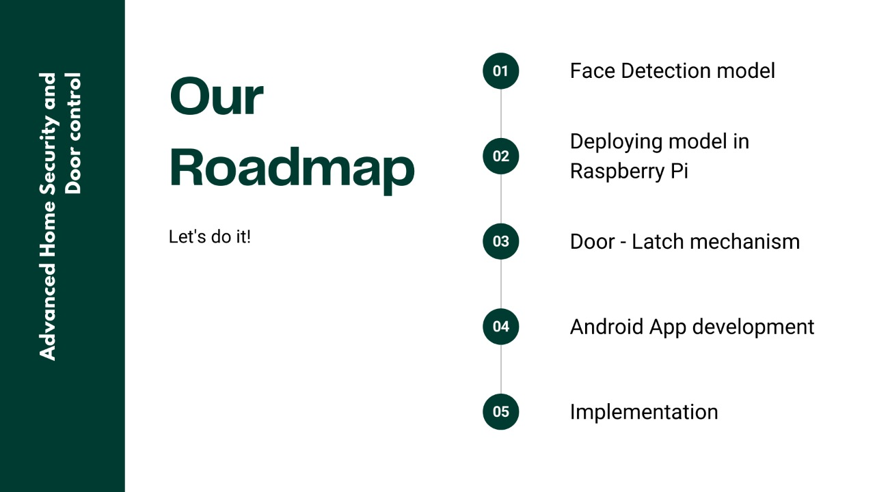
Roadmap

Slide 9
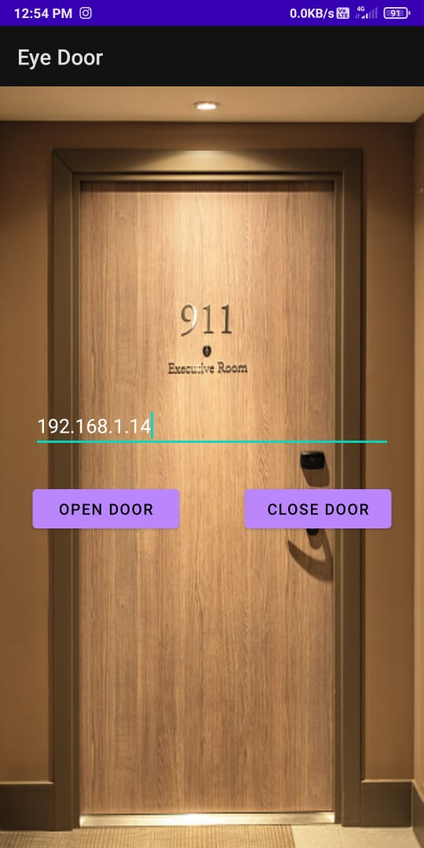
Work carried
RESTful APIs that we made helps to integrate the app and the door-latch.
APIs are hosted in Raspberry Pi server.
Rasp. Pi gets and processes the request
Firebase messaging cloud service are used to send notifications to App.

Slide 10
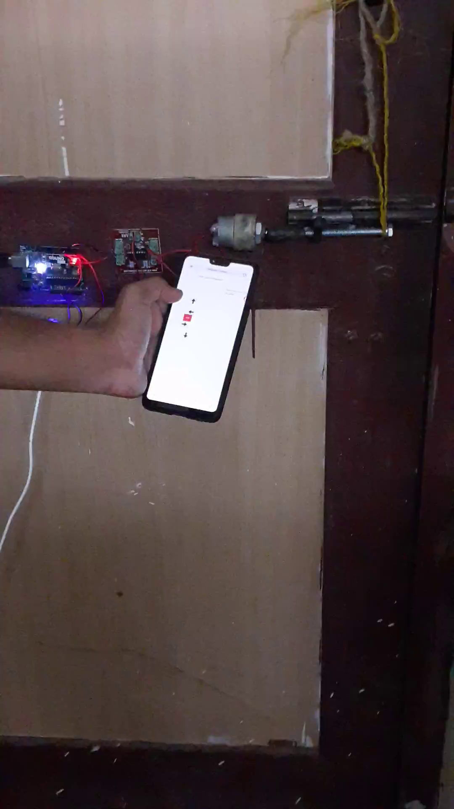
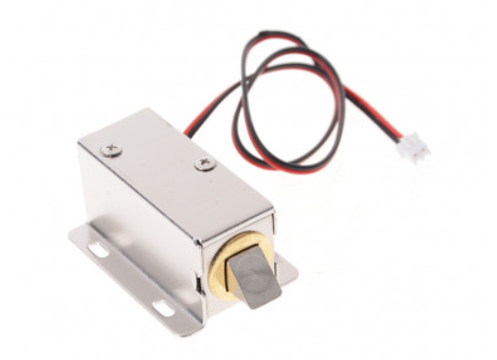
Door Latch Setup
Video

Slide 11
Future Work Plan
Integration of door-latch mechanism
Improvised door-latch
Face recognition
Notification alert
Adding features in app
Aesthetic UI

Slide 12
Thank you !

